Slide 1
Sociology 125
Lecture 14
Poverty & Inequality
March 7, 2017

Slide 2
Recapitulation:
THREE APPROACHES TO CLASS
Class concept | Key Idea
Individual attributes | One person’s class position does not affect anyone else’s
Opportunity-hoarding | The advantages of being in a privileged class position causally depend on the disadvantages of others (“exclusion”)
Domination & exploitation | The advantages of being in a privileged class position causally depend on two things: exclusion and controlling the activities of others.

Slide 3
THE COMPOSITE AMERICAN CLASS STRUCTURE
An extremely rich capitalist/corporate managerial class
Historically a large and stable middle class anchored in possession of educational credentials, with an uncertain future.
A working class that was once supported by a strong labor movement with living standards overlapping the middle class, but now quite vulnerable.
The working poor: A poor segment of the working class, with low wages, unconstrained competition, high vulnerability.
The underclass: A marginalized population living in desperate poverty.

Slide 4
An Empirical Profile of Inequality in America

Slide 5
Household income
Household net Financial Assets
Bottom 90%
Richest 1%
Richest 1% of households
Next richest 9% of households
Bottom 90% of households
Distribution of Household Income and Wealth, 2010

Slide 6
The Great U-Turn in Inequality

Slide 7
The Great U-Turn in Inequality

Slide 8
The Great U-Turn in Inequality
22.5%
9%

Slide 9
Annual rate of growth of family income by income group
1947-79 compared to 1979-2005

Slide 10
Top 1% compared to middle
Just below top 1% compared to middle
Middle compared to bottom 20%

Slide 11
Earnings Growth at the Very Top of the Income Distribution
1972-2001

Slide 12
Ratio of Average CEO to Average Worker pay, 1965-2007
1965 1972 1978 1989 1997 2000 2005
From Mishel, et. al. The State of working America, 2008-09, Figure 3AE

Slide 13
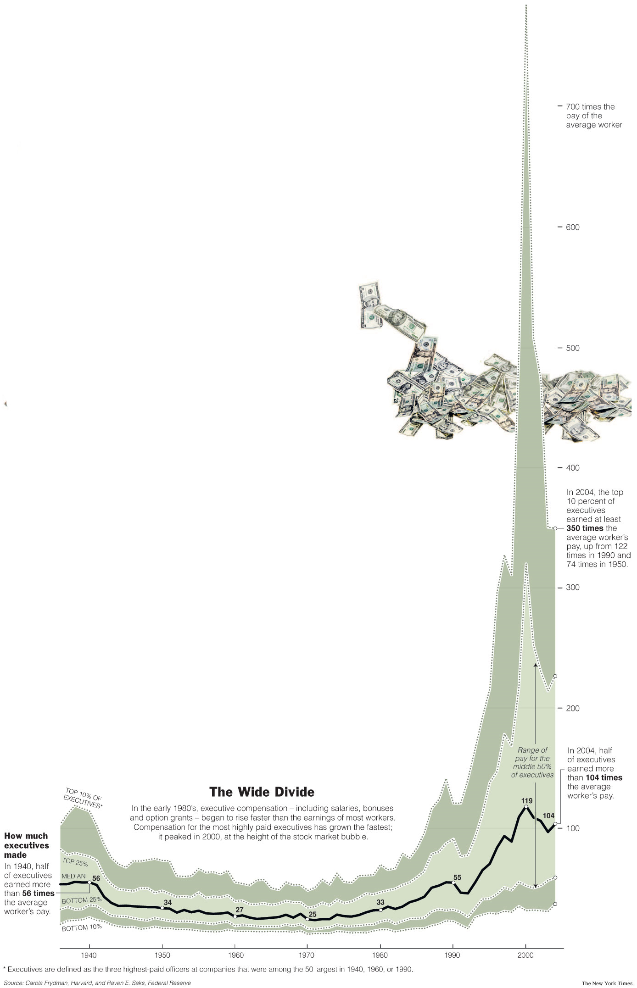
Ratio of executive pay to Average worker pay
1940s-2000s
700 times the pay of average workers
600
Executives = 3 highest paid officers in companies that were among the 50 largest in 1940, 1960, or 1990
500
Top 10% of executives
400
300
Median executive
Bottom 10% of executives
200
100
1940
1950
1960
1970
1980
1990
2000
Source: New York Times 4/8/2006

Slide 14
Class Origins of People in the “Forbes 400” list
of wealthiest people in the U.S.

Slide 15
An Empirical Profile of Poverty in America

Slide 16
Relative Poverty Rates
(% with income < .5 national median)

Slide 17
Changes in Child Poverty Rate and National Income, 1959-2013

Slide 18
Growth of intense poverty:
% of poor living below half of the poverty line

Slide 19
Poverty Rates by race and Ethnicity, 1973-2011

Slide 20
Two broad types of explanations of persistent poverty:
Blame the victim
Blame society

Slide 21
Blame the Victim
Basic idea: The problem is in the attributes of poor people; the solution is to change the person, not the society.

Slide 22
Blame the victim
Simple reasoning:
Some people who are born poor become rich, others do not, sometimes even within a family.
There must be something different between those who stay poor and those who do not which explains the different outcomes.
Therefore the explanation of poverty must be this individual difference: there must be a personal deficit of some sort.

Slide 23
Blame the victim
Simple reasoning:
Some people who are born poor become rich, others do not, sometimes even within a family.
There must be something different between those who stay poor and those who do not which explains the different outcomes.
Therefore the explanation of poverty must be this individual difference: there must be a personal deficit of some sort.

Slide 24
Blame the victim
Simple reasoning:
Some people who are born poor become rich, others do not, sometimes even within a family.
There must be something different between those who stay poor and those who do not which explains the different outcomes.
Therefore the explanation of poverty must be this individual difference: there must be a personal deficit of some sort.
Notes:
The explanation for poverty is reduced to the explanation for why particular people are poor.
GRASSHOPPER AND THE ANT: The grasshopper’s poverty is his own fault.
Examples:
Genetic inferiority
Cultural inferiority, especially culture of poverty – can’t delay gratification

Slide 25
Ideological attractiveness of BTV to people with advantages:
A painless way of explaining social problems that does not threaten people on the top.
Notes:
The poor should take responsibility for their own plight and stop complaining.

Slide 26
Blame Society
Basic idea: Circumstances vary much more between the poor and the non-poor do than personalities, motivations or values.
Notes:
Remember the grading example.

Slide 27
Middle class people vs poor people
Motivations: delayed gratification is an issue for both poor and middle class, e.g. credit card debt
Crime: white collar crime (eg. tax evasion) at least as prevalent as crimes of the poor.

Slide 28
Middle class people vs poor people
Motivations: delayed gratification is an issue for both poor and middle class, e.g. credit card debt
Crime: white collar crime (e.g. tax evasion) is at least as prevalent as crimes of the poor.
Notes:
BASIC TAKE HOME MESSAGE:

Slide 29
Basic take-home message:
Even when individual attributes are relevant to explaining poverty, they are never a sufficient explanation.
Notes:
Having little education only explains poverty given the social environment in which the person lives, so it is never adequate to simply blame the victim.
Remember the grading curve example.

Slide 30
SOCIAL STRUCTURAL EXPLANATIONS OF INEQUALITY AND POVERTY
Marginalization: Exclusion from labor markets
Inequality processes within labor markets
Processes which generate inequality in wealth

Slide 31
Social Structural causes of inequality and poverty:
#1 Marginalization
Definition: the process of being excluded from stable participation in the labor force.
Three issues:
Simple observation: lack of adequate employment for people with low skills or with outmoded skills.
This is NOT just a problem of inadequate skill formation. It is equally a problem of inadequate job creation.
The consequences of marginalization are intensified because of lack of real safety-net.

Slide 32
Social Structural causes of inequality and poverty:
#1 Marginalization
Definition: the process of being excluded from stable participation in the labor force.
Three issues:
Simple observation: lack of adequate employment for people with low skills or with outmoded skills.
This is NOT just a problem of inadequate skill formation. It is equally a problem of inadequate job creation.
The consequences of marginalization are intensified because of lack of real safety-net.

Slide 33
Social Structural causes of inequality and poverty:
#1 Marginalization
Definition: the process of being excluded from stable participation in the labor force.
Three issues:
Simple observation: lack of adequate employment for people with low skills or with outmoded skills.
This is NOT just a problem of inadequate skill formation. It is equally a problem of inadequate job creation.
The consequences of marginalization are intensified because of lack of real safety-net.
Notes:
there are plenty of tasks that need to be done within the US that require relatively little skill; the problem = they cannot be done profitably. Examples: elder care, childcare, rehabilitating central cities. Why is elder care so badly paid?

Slide 34
Social Structural causes of inequality and poverty:
#1 Marginalization
Definition: the process of being excluded from stable participation in the labor force.
Three issues:
Simple observation: lack of adequate employment for people with low skills or with outmoded skills.
This is NOT just a problem of inadequate skill formation. It is equally a problem of inadequate job creation.
The consequences of marginalization are intensified because of lack of real safety-net.

Slide 35
Poverty Rates before & after income transfers
Pre-transfer poverty rate
Post-transfer poverty rate

Slide 36
Social Structural causes of inequality:
#2. Inequalities within labor markets
a) Two possible ways of organizing the process of connecting wages to jobs:
1. Individualized competition
2. Labor market governed by rules which dampen competition
b) Why does intensification of competitiveness (deregulation) lead to increasing inequality?
c) Explanation for intensification of competition in the U.S.A.:
Decline of unions
Decline of government regulation
Increased global competition
d) Technological change
Notes:
working poor + enormous wage inequalities at the top.

Slide 37
Social Structural causes of inequality:
#2. Inequalities within labor markets
a) Two possible ways of organizing the process of connecting wages to jobs:
1. Individualized competition
2. Labor market governed by rules which dampen competition
b) Why does intensification of competitiveness (deregulation) lead to increasing inequality?
c) Explanation for intensification of competition in the U.S.A.:
Decline of unions
Decline of government regulation
Increased global competition
d) Technological change
Notes:
1. intense individualized competition, everyone bidding against everyone else, constant jockying around, employers lowering and raising wages as they compete for workers, etc.
2. a labor market governed by rules which dampen competition: seniority pay rather than intense individual competition; high job security; unions and other devices for reducing wage spread (like a high minimum wage)

Slide 38
Social Structural causes of inequality:
#2. Inequalities within labor markets
a) Two possible ways of organizing the process of connecting wages to jobs:
1. Individualized competition
2. Labor market governed by rules which dampen competition
b) Intensification of competitiveness (deregulation) leads to increasing inequality.
c) Explanation for intensification of competition in the U.S.A.:
Decline of unions
Decline of government regulation
Increased global competition
d) Technological change
Notes:
Americans like to think that because competition is a good thing, the more competition the better. Is this true?
Constant upward & downward adjustment leads to greater spread
Winner-take-all markets: small differences in performance generate big differences in outcomes
Giant pay at top increases spread
Deregulation of work and lack of enforcement of pay rules (increase in sweatshops)
Increasing global competition pushes down wages at the bottom (but sometimes also among technical workers – x-ray reading in India)

Slide 39
Social Structural causes of inequality:
#2. Inequalities within labor markets
a) Two possible ways of organizing the process of connecting wages to jobs:
1. Individualized competition
2. Labor market governed by rules which dampen competition
b) Intensification of competitiveness (deregulation) leads to increasing inequality.
c) Explanation for intensification of competition in the U.S.A.:
Decline of unions
Decline of government regulation
Increased global competition
d) Technological change

Slide 40
Social Structural causes of inequality:
#2. Inequalities within labor markets
a) Two possible ways of organizing the process of connecting wages to jobs:
1. Individualized competition
2. Labor market governed by rules which dampen competition
b) Intensification of competitiveness (deregulation) leads to increasing inequality.
c) Explanation for intensification of competition in the U.S.A.
Decline of unions
Decline of government regulation
Increased global competition
d) Technological change

Slide 41
Social Structural causes of inequality:
#3 Wealth inequality
Difficult for average person to accumulate much wealth through savings.
Stagnation of household income since the early 1970s means that discretionary income for most people has not grown much.
Fantastic rise in employment earnings at high end of market has allowed professionals and managers to turn surplus earnings into capitalist wealth (stocks, bonds, etc.)

Slide 42
Social Structural causes of inequality:
#3 Wealth inequality
Difficult for average person to accumulate much wealth through savings.
Stagnation of household income since the early 1970s means that discretionary income for most people has not grown much.
Fantastic rise in employment earnings at high end of market has allowed professionals and managers to turn surplus earnings into capitalist wealth (stocks, bonds, etc.)

Slide 43
Social Structural causes of inequality:
#3 Wealth inequality
Difficult for average person to accumulate much wealth through savings.
Stagnation of household income since the early 1970s means that discretionary income for most people has not grown much.
Fantastic rise in employment earnings at high end of market has allowed professionals and managers to turn surplus earnings into capitalist wealth (stocks, bonds, etc.)

